Slide 1
Basketball Court Design
Team Design: Adel Alnasser
Daij Alfahad
Hamad Alqalaf

Slide 2
Overview
Project Understanding
Scope of Services
Schedule
Cost of The Project
Project Summary

Slide 3
Project Understanding
Stakeholders, Client and Technical Advisor
Project Description
Background Information
Purpose of The Project

Slide 4
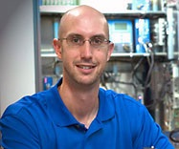
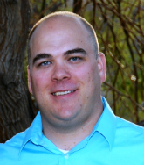
Stakeholders, Client and Technical Advisor
Stakeholder:
Homeowner Association Management
Client: Dr. Edward Smaglik
Technical Advisor: Mr. Mark Lamer

Slide 5
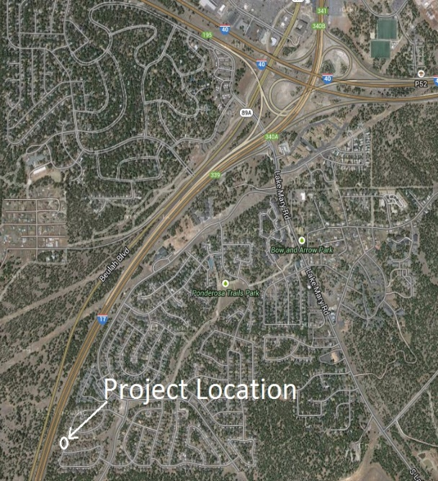
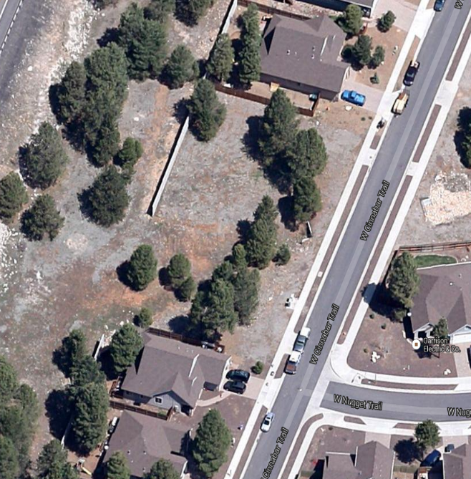
Project Description
The design of full basketball court with maintaining the existing drainage system.
Location:
590 W Cinnabar Trail, Flagstaff AZ, 86005
Area of the empty land is:
4.79 Acres

Slide 6
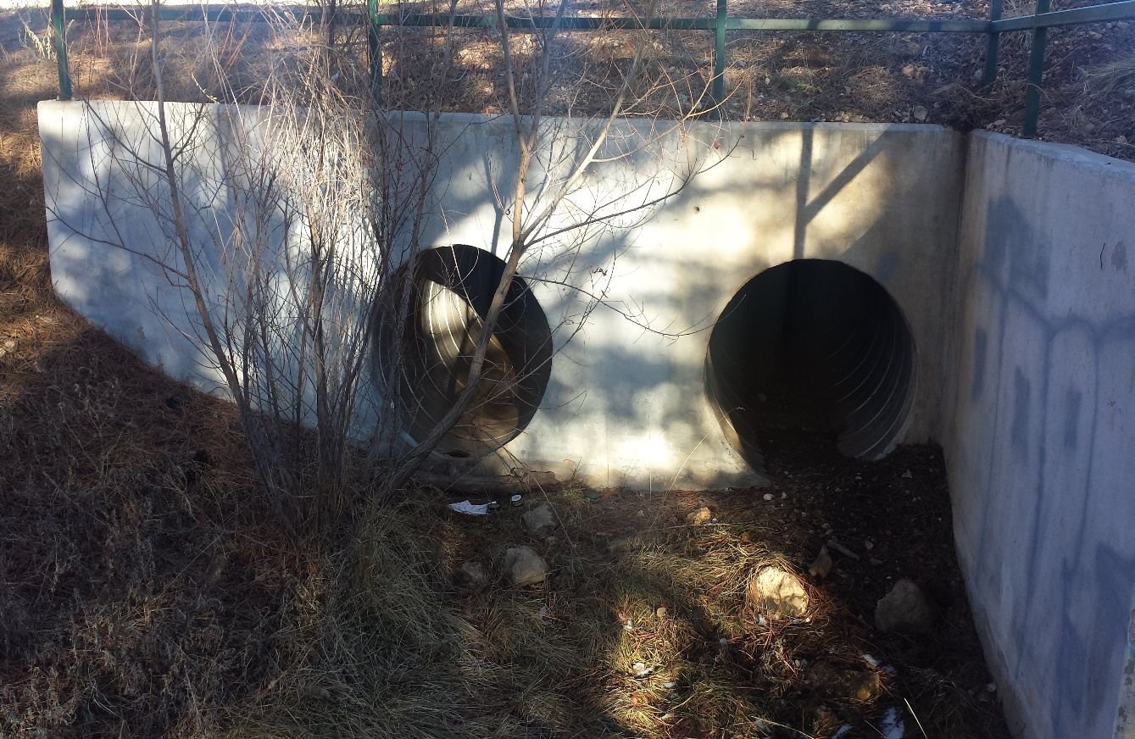
Background Information
The land existing condition.
Detention Basin
Trees
No Parking
Located in Between two houses.

Slide 7
Purpose of The Project
Site Development.
The project will occupy the empty land.
The project will meet the resident's satisfaction.

Slide 8
Scope of Services
Task 1: Project management
Task 2: Data Collection
Task 3: Surveying
Task 4: Hydrology Analysis
Task 5: Geotechnical Analysis
Task 6: Drainage System Design
Task 7: Court Design
Task 8: Additional Features
Task 9: Traffic Analysis
Task 10: Final Design

Slide 9
Task 1: Project management
1.1 Professional Meetings
1.2 Team Meetings
Task 2: Data Collection
2.1 Meeting with Homeowner Association
2.2 Policies and Regulations Research
Task 3: Surveying
3.1 Data Collection
3.2 Topographic Map
Task 4: Hydrology Analysis
4.1 Existing Infrastructure Analysis
4.2 Runoff Analysis

Slide 10
Task 5: Geotechnical Analysis
5.1 Soil Analysis
5.2 Cut/Fill and Compaction
Task 6: Drainage System Design
6.1 Improving The Design of The Detention Basin
Task 7: Court Design
7.1 Court Dimensions
7.2 Court Surface Material
7.3 Basketball Court Equipment
Task 8: Additional Features
8.1 Sidewalk and Benches
8.2 Fence

Slide 11
Task 9: Traffic Analysis
9.1 Traffic Signage
9.2 Traffic Striping
Task 10: Final Design
10.1 Design Report
10.2 Presentation
10.3 Website

Slide 12
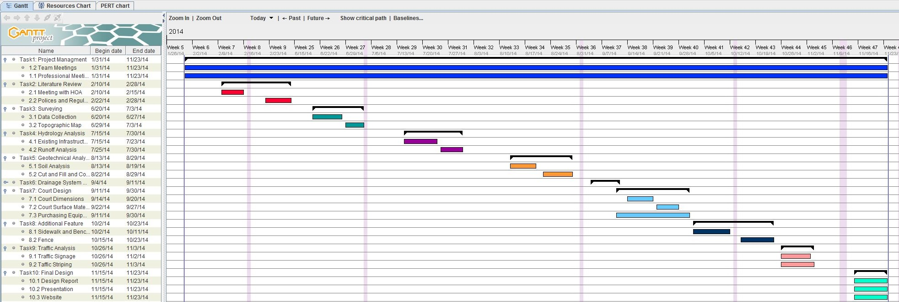
Schedule

Slide 13
Cost of The Project
Tasks | Staff | Classification | Rate ($/hr) | Hours | Cost Estimate($)
1.1 Professional Meetings | Hamad Alqalaf Adel Alnasser Daij Alfahad | Engineering | 80 | 30 | 2400
1.2 Team meetings | Hamad Alqalaf Adel Alnasser Daij Alfahad | Engineering | 80 | 46 | 3680
2.1 meeting with Home Owner Association | Adel Alnasser Daij Alfahad | Engineering | 80 | 12 | 960
2.2 Policies and Regulations Research | Hamad Alqalaf Adel Alnasser | Engineering | 80 | 24 | 1920
3.1 Data Collection | Hamad Alqalaf Daij Alfahad | Technician | 45 | 24 | 1080
3.2 Topographic Map | Hamad Alqalaf Adel Alnasser Daij Alfahad | Technician | 45 | 15 | 675
4.1 Existing Infrastructures Analysis | Hamad Alqalaf Daij Alfahad | Engineering | 80 | 16 | 1280
4.2 runoff analysis | Adel Alnasser Daij Alfahad | Engineering | 80 | 16 | 1280
5.1 Soil Analysis | Hamad Alqalaf Adel Alnasser | Engineering | 80 | 16 | 1280
5.2 Cut and Fill and Compaction. | Adel Alnasser Daij Alfahad | Engineering | 80 | 16 | 1280

Slide 14
Cost of The Project Continued
Tasks | Staff | Classification | Rate ($/hr) | Hours | Cost Estimate($)
6.1 Open Channel Design | Hamad Alqalaf Daij Alfahad | Engineering | 80 | 22 | 1760
7.1 court dimensions | Adel Alnasser | Technician | 45 | 20 | 900
7.2 court surface material | Hamad Alqalaf Adel Alnasser Daij Alfahad | Technician | 45 | 36 | 1620
7.3 Purchasing Equipment | Hamad Alqalaf Adel Alnasser Daij Alfahad | Engineering | 80 | 18 | 1440
8.1 Sidewalk and benches | Adel Alnasser | Engineering | 80 | 12 | 960
8.2 Fence | Daij Alfahad | Engineering | 80 | 12 | 960
9.1 Traffic Signage | Hamad Alqalaf | Technician | 45 | 18 | 810
9.2 Traffic Striping | Daij Alfahad | Technician | 45 | 18 | 810
10.1 Design Report | Hamad Alqalaf Adel Alnasser Daij Alfahad | Engineering | 80 | 18 | 1440
10.2 Presentation | Hamad Alqalaf Adel Alnasser Daij Alfahad | Engineering | 80 | 24 | 1920
10.3 Website | Daij Alfahad | Technician | 45 | 16 | 720
Total |  |  |  | 429 | $ 29175

Slide 15
Project Summary
Full Basketball Court Design
Maintaining The Existing Detention Basin
10 Main Tasks
Total Cost of $29175 for 429 Hours of Engineering and Technician Work

Slide 16
References
[1] CIVIL AND ENVIRONMENTAL ENGINEERING DIRECTORY . N.d. Photograph. www.nau.edu, Flagstaff. Web. 13 Apr 2014. <http://nau.edu/CEFNS/Engineering/Civil-Environmental/Directory/Lamer/>.
[2] NAU'S FUNHOUSE OF TRAFFIC TOYS. 2011. Photograph. www.research.nau.edu, Flagstaff. Web. 13 Apr 2014. <https://www.research.nau.edu/newsletter/spring2011/aztrans.asp&xgt;.

Slide 17
Questions?

